Slide 1
MX BANDWIDTH CHARACTERIZATION All future Bandwidth capacities should be considered targets and subject to change
Q3 2018
Routing PLM Team

Slide 2
Legal Disclaimer
This product roadmap sets forth Juniper Networks’ current intention and is subject to change at any time without notice. No purchases are contingent upon Juniper Networks delivering any feature or functionality depicted on this roadmap

Slide 3
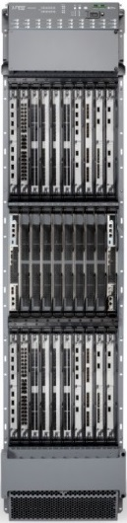
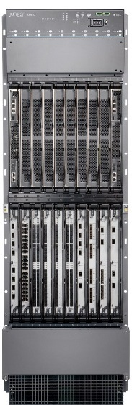
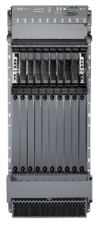
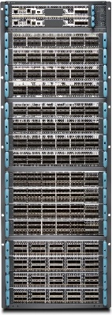
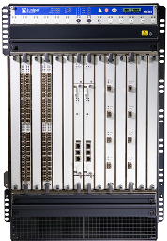

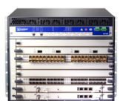
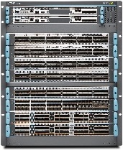
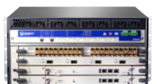



MX PORTFOLIO OVERVIEW
 | MX150 | VMX
 | MX80, MX104
 | MX240, MX480, MX960
 | MX204, MX10003
 | MX2008, MX2010, MX2020
 | MX10008
 | MX10016
 | 20G | 100G
 | 80G
 | 1T
 | 3T
 | 5T
 | 400G | 2.4T
 | 16T
 | 16T
 | 32T
 | 19.2T
 | 38.4T
2016-2018
 | 3T
 | 8T
 | 13.5T
 | 40T
 | 40T
 | 80T
2018-2019
 | 2.4T/slot (Target 3.2T)
 | 3.2T | 19.2T
 | 8.0T/slot (Target 9.6T)
 | 76T+
 | 153T+
2020-2021

Slide 4

MX ASIC Roadmap

Slide 5
TRIO ASIC Evolution
SLOT CAPACITIES, GBPS, AND LINE CARDS
MX
40
160
260
240
480
1500
2400
MX2K
480
1600
4000
9600
MX10K
2400
9600
DPCE
MPC1/2 MPC16x10GE
MPC4E
MPC3E
MPC5E/6E NG-MPC2E/3E
MPC7E
MPC8E/9E
MPC10E
MPC11E
MPC12E
MPC13E
FEATURES
FLEX ETHERNET ····
IPSEC, MACSEC ·····
TELEMETRY EXPORT ····················
INTEGRATED H-QOS ·······················
TURBO FILTERS ·························································
HIGH SPEED AND HIGH SCALE H-QOS ························
ROUTE AND FLOW SCALE INCREASE ·························
PHY TIMESTAMPING ··········································································
PROGRAMMABLE PARSING, LOOKUP AND ENCAPSULATION ············································
I-CHIP
TRIO 1.0 LU, MQ, QX
TRIO 1.5 LU, XM
TRIO 2.0 XL, XM, XQ
TRIO 3.0 EA
TRIO 4.0 ZT
TRIO 5.0 YT
2007
2009 – 2010
2012
2014
2016
2018
2020
Notes:
Key Message : With each generation integrated new functionality and feature; SW model is same which enables faster time to market of new generation of silicon. We follow the same model as processor industry by increasing number of packet forwarding engines inside our ASIC.

Slide 6
MX Fabric Roadmap

Slide 7

MX240/480/960 Fabric Evolution
Gen 4
(ZF)
MX240/480/960 system
Gen 3
(XF2)
SCBE3 – 1.5T
Gen 2
(XF)
SCBE2 – 480G
Gen 1
(SF)
SCBE – 240G
SCB – 120G
2007
2011
2013
2018

Slide 8
MX2K Fabric Evolution
Gen 3
(ZF)
MX2K system
SFB3 – 4.0T
Gen 2
(PF)
Gen 1
(XF)
SFB2– 2T
SFB – 800G
2012
2015
2019

Slide 9
MX Bandwidth Characterization

Slide 10
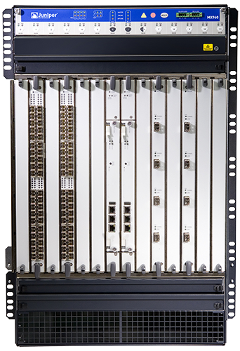
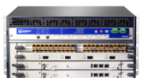
MX240, MX480 and MX960 Line Rate Ports
Per Slot Capacity
Interface | 1H 2012 | 2H 2012 | 2H 2013 | 2015 | 2018+
1GE | 40
10GE | 16 | 24 | 26 | 48 | 60
40GE | 3 |  | 6 | 12 | 15
100GE | 1 | 2 | 2 | 4 | 15
Per Chassis Capacity
Interface | 2H 2012 | 1H 2013 | 2H 2013 | 2015 | 2018+
1GE | 440
10GE | 176 | 256 | 286 | 528 | 648
40GE | 33 |  | 66 | 132 | 154
100GE | 11 | 22 | 22 | 44 | 154

Slide 11
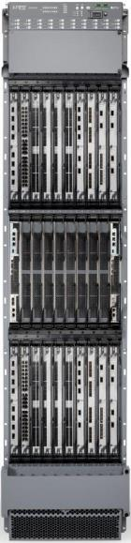
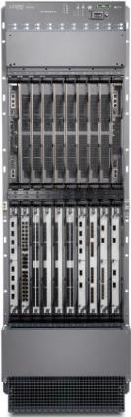
MX2K Line Rate Ports
Per Slot Capacity
Interface | 2012 | 2013 | 2014 | 2015 | 2016 | 2018+
1GE | 40
10GE | 16 | 26 | 48 | 96 |  | 128
40GE | 3 |  | 6 | 24 |  | 32
100GE | 1 | 2 | 4 | 16 |  | 40
400GE |  |  |  |  |  | 8
Per Chassis Capacity
Interface | 2012 | 2013 | 2014 | 2015 | 2016 | 2018+
1GE | 800
10GE | 320 | 520 | 960 | 1920 |  | 2560
40GE | 60 |  | 120 | 480 |  | 640
100GE | 20 | 40 | 80 | 320 |  | 800
400GE |  |  |  |  |  | 160

Slide 12
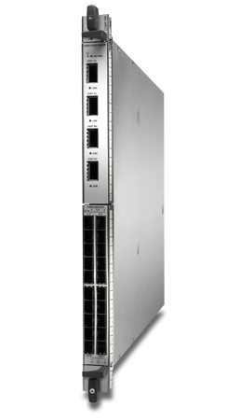
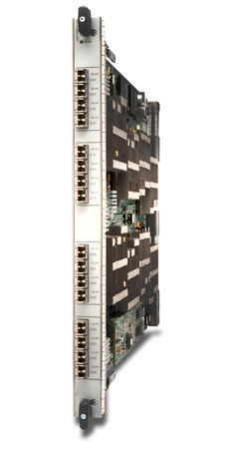
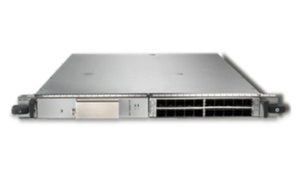
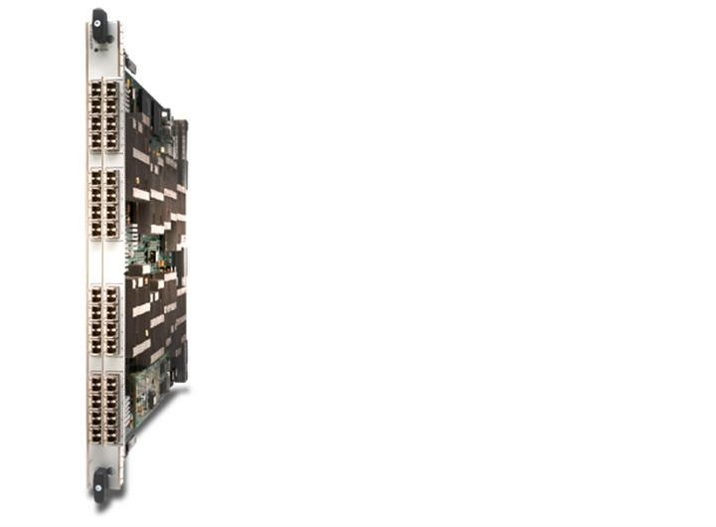


Shipping MX MPC and client optics summary
MPC Type/Description | Total MPC PFE Bandwidth | 10G Optic | 100G Optic | 40G Optic | Availability on MX240/480/960 | Supported on MX2K
MPC 1 & MPC2 (-Q/-EQ) 2 MIC slots (1GE,10GE) | 40 & 80 Gbps | XFP | N/A | N/A | 2010 | 2H2012
16 x 10GE Fixed MPC | 160 Gbps | SFP+ | N/A | N/A | 2010 | 2H2012
MPC3 2 MIC slots (100GE,40GE,10GE) | 130 Gbps |  | CFP & CXP | QSFP+ | 2012 | 2H2012
MPC4 32 x 10GE Fixed MPC 2x100GE + 8x10GE Fixed MPC | 260 Gbps |  | CFP | N/A | 1H2013 | 1H2013
MPC5: 240G HQOS MPC 24x10GE or 6x40GE Fixed MPC 2x100GE + 4x10GE Fixed MPC | 240 Gbps |  | CFP2 | QSFP+ | 2H2014 | 2H2014
MPC2E-NG and MPC3E-NG | 80G/130G |  | CFP |  | 2015 | 2015
MPC6: MX2020 480G MPC 2 MIC slots (10GE, 100GE) | 480 Gbps |  | CFP2 | N/A | NO | 1H2014

Slide 13
MX MPC and Client Optics Summary Roadmap
MPC Type/Description | Total MPC Bandwidth | Optics |  |  |  | Availability on MX240/480/960 | Supported on MX2K
 |  | 10G | 100G | 40G | 400G
MPC7 - 480G MPC | 480 Gbps [except MX2K] 430 Gbps [MX2K] | QSFP+ with 4 x 10G breakout and SFP+ | QSFP28 | QSFP+ | N/A | Q4 2015 | Q4 2015
MPC8 – 960G MPC for MX2K | 960 Gbps | QSFP+ with 4 x 10G breakout |  |  |  | NO | Q1/Q2 2016
MPC9 - 1.6T MPC for MX2K | 1.6 Tbps |  |  |  |  | NO
MPC10 – 1.5T MX960 MPC | 1.5Tbps | QSFP+ with 4x10G breakout |  |  | TBD | 2017/2018 | NO
MPC11 – 4.0T MX2K MPC | 4.0Tbps | TBDQSFP+ with 4x10G breakout |  |  | QSFP56-DD | NO | 2018/2019

Slide 14
MPC summary
MPC | #of PFE | PFE Capacity | MPC Capacity | Flexible Queuing | IR Mode License | Hypermode | MX240/480/960 | MX2K
MPC1E | 1 | 40G | 40G | No | No | No | Yes | Yes
MPC2E | 2 | 40G | 80G | No | No | No | Yes | Yes
16x10MPC | 4 | 40G | 160G | No | No | No | Yes | Yes
MPC3E | 1 | 130G | 130G | No | No | Yes | Yes | Yes
MPC4E | 2 | 130G | 260G | Yes | Yes | Yes | Yes | Yes
MPC5E | 2 | 120G | 240G | Yes | Yes | Yes | Yes | Yes
MPC2E-NG | 1 | 80G | 80G | Yes | Yes | N/A | Yes | Yes
MPC3E-NG | 1 | 130G | 130G | Yes | Yes | N/A | Yes | Yes
MPC6E | 4 | 130G | 520G | No | Yes | Yes | No | Yes
MPC7E | 2 | 240G | 480G | Yes | Yes | Yes | Yes | Yes
MPC8E | 4 | 240G | 960G | Yes | Yes | Yes | No | Yes
MPC9E | 4 | 400G | 1600G | Yes | Yes | Yes | No | Yes
MPC10E | 3 | 500G | 1500G | Yes | Yes | Yes | Yes | No
MPC11E | 8 | 500G | 4000G | Yes | Yes | Yes | No | Yes
Flexible Queueing Option : License to increase 8q/port to 32,000 queues per slot
IR Mode : All MPLS and L2 features of –X mode; Full IP FIB for peering/transit; 16 VPNs per MPC
Hypermode : Increases throughput and performance by reducing instructions executed per packet

Slide 15
Fabric

Slide 16
SCB/SCBE/SCBE2/SCBE3 terminology - MX240/480/960
For the rest of the document, the following nomenclature will be used
SCB refers to the 1st generation fabric on MX960/MX480/MX240
Uses SF ASIC
This is the fabric card was released at MX960 FRS
SCBE refers to the 2nd generation fabric on MX960/MX480/MX240
Uses XF ASIC
This is the fabric card was released in Junos 11.4
SCBE2 refers to the 3rd generation fabric on MX960/MX480/MX240
Uses XF2 ASIC
Support 480G per line card on MX960/MX480/MX240
This card was released with Junos 13.3R1
SCBE3 refers to the 4th generation fabric on MX960/MX480/MX240
Will support 1.5T per line card on MX960/MX480/MX240
The current release target is 2H 2018

Slide 17
MPC – FABRIC SUPPORT MATRIX
 |  | MX240/480/960 |  |  |  | MX2000
Mixed Mode Allowed (DPC+MPC in a chassis) |  | Mixed Mode Allowed (DPC+MPC in a chassis) |  | Enhanced-IP/Enhanced-Ethernet mode Only
 | Line Cards/Fabric | SCB | SCBE | SCBE2 | SCBE3* | SFB | SFB2 | SFB3*
 | DPC/MS-DPC | Yes | Yes | No | No | No | No | No
 | MS-MPC | Yes | Yes | Yes | Yes | Yes | Yes* | No
 | MPC1/MPC2 | Yes | Yes | Yes | No | Yes | Yes | No
 | MPC3 | Yes | Yes | Yes | Yes | Yes | Yes | Yes
 | 16x10G MPC | Yes | Yes | Yes | Yes | Yes | Yes | No
 | MPC4 | No | Yes | Yes | Yes | Yes | Yes | Yes
 | MPC2-NG/MPC3-NG | No | Yes | Yes | Yes | Yes | Yes | Yes
Enhanced-IP/ Enhanced-Ethernet mode only | MPC5 | No | Yes | Yes | Yes | Yes | Yes | Yes
 | MPC6 | No | No | No | No | Yes | Yes | Yes
 | MPC7: 480G (Except MX2K), 430G (MX2K) | No | No | Yes | Yes | Yes | Yes | Yes
 | MPC8 (960Gbps)/ MPC9 (1.6Tbps) | No | No | No | No | Yes | Yes | Yes
 | MPC10 for MX960 (1.5T)* | No | No | No | Yes | No | Yes | No
 | MPC11 for MX2K (4.0T)* | No | No | No | No | No | No | Yes
* Roadmap Items; Check Release Notes for Junos release

Slide 18
MPC – JUNOS Support Matrix
Line Cards | First JUNOS version supported
MPC1E/MPC2E | 11.2R4 on MX240/MX480/MX960; 12.3R1 on MX2010/MX2020
MPC3E | 12.1R1 on MX240/MX480/MX960; 12.3R1 on MX2010/MX2020
16x10G MPC | 10.0R2 on MX240/MX480/MX960; 12.3R1 on MX2010/MX2020
MPC4E | 12.3R2
MPC2E-NG/MPC3E-NG | 15.1R1; 14.1R4 OR 14.2R3 with Junos Continuity
MPC5E | 13.3R3
MPC6E | 13.3R3
MPC7E | 16.1R1; 15.1F4 with Junos Continuity
MPC8E/ MPC9E | 16.1R1; 15.1F5 with Junos Continuity

Slide 19
RE – JUNOS Support Matrix
Routing Engine (MX240, MX480, MX960) | First supported 32 bit JUNOS Release | First Supported 64 bit JUNOS Release
RE-S-1800X4-16G | 11.4R5; 12.1R3 | 10.4
RE-S-1800X4-32G | 12.3R4; 13.2R1 | 12.3R4; 13.2R1
RE-S-X6-64G (not supported on SCB, SCBE) | ---- | 15.1F4
Routing Engine (MX2010/MX2020) | First supported 32 bit JUNOS Release | First Supported 64 bit JUNOS Release
REMX2K-X8-64G | ---- | 15.1F5

Slide 20
Bandwidth Characterization
Bandwidth per PFE is dependent on three factors
Memory bandwidth for packet reads and writes
The bandwidth to/from the fabric
The packets per second processing capacity
Packet read/write memory hard enforces the maximum bandwidth
This is based on what the PFE “sees”
Fabric capacity varies for the same PFE
Number of PFEs per line card
Speed and number of fabric links on the chassis
Fabric chip
Bandwidth numbers reported by a Router Tester can vary
L3/MPLS bandwidth is reported higher, since L2 encapsulation is removed
L3/MPLS is “simpler”
VPLS and L2 bridging/switching carries a higher burden
L2 encapsulation is carried through the PFE and the fabric
PPS for L2/VPLS is typically lower

Slide 21
Fabric Planes
Chassis Type | # of planes | # of Fabric cards | # of planes/fabric
MX960 | 6 planes | 3 | 2
MX480 | 8 planes | 2 | 4
MX240 | 8 planes | 2 | 4

Slide 22
MX960 Line-card Fabric Midplane Bandwidth
Per Slot Bandwidth in Gbps | 2007 | 2009 | 2011 | 2012 | 2013 | 2013 | 2015 | 2018
Line Rate Bandwidth¹ | 40G | 160G | 160G | 160G | 260G | 260G | 480G | 1500G
Fabric Bandwidth Redundant [Non-Redundant] | 80[120] | 80[120] | 160[240] | 160[240] | 160[240] | 340[480] | 340[480] | 1000[1500]
PREMIUM2 Midplane Bandwidth Redundant [Non-Redundant] | 340[480] | 340[480] | 340[480] | 340[480] | 340[480] | 340[480] | 340[480] | 640[1000]
PREMIUM3 Midplane Bandwidth Redundant [Non-Redundant] | 340[480] | 340[480] | 340[480] | 340[480] | 340[480] | 340[480] | 340[480] | 1000[1500]
What’s New | DPC | 16x10 MPC | SCBE | Enhanced Midplane Connector² | MPC4E | SCBE2 | MPC7E | SCBE3 and MPC10E
Usable Full-Duplex Line-rate Bandwidth ² | 40G | 120G | 160G | 160G | 240G | 260G | 480G | 1500G
Notes:
Line-rate capacity supported for each line-card slot; equally divided among the number of PFEs
Usable bandwidth is MIN(Line card BW, Fabric Capacity, Midplane)

Slide 23
MX2K Line-card Fabric Midplane Bandwidth
 | 2012 | 2013 | 2016 | 2016 | 2017/2018
Line Card Line Rate BW | 260G | 480G | 1.6T | 1.6T | 4.0T
Fabric – BW per LC Redundant [Non-Redundant] | 700[800] | 700[800] | 1.7T | 1.7T[2.0T] | 3.5T[4.0T]
Midplane | 1.1T | 1.1T | 2.4T | 2.4T | 4.8T
What’s New | MPC4E | MPC6E | SFB2 | MPC9E | MPC11E
Usable full-duplex Line-rate slot BW | 260G | 480G | 1.6T | 1.6T | 4.0T
Notes:
Notes:
Line-rate capacity supported for each line-card slot; equally divided among the number of PFEs
Usable bandwidth is MIN(Line card BW, Fabric Capacity, Midplane)

Slide 24
MPC Fabric Bandwidth Summary (with SCB)
Fabric Bandwidth per PFE: SCB
MPC |  | MX960 |  | MX480/MX240
 | #of SCBs | 3 | 2 | 2 | 1
 | (# of PFEs/BW per PFE)
MPC1E | (1/40G) | 40G | 40G | 40G | 40G
MPC2E | (2/40G) | 40G | 40G | 40G | 40G
16x10GE | (4/40G) | 30G | 20G | 40G | 20G
MPC1: 1 PFE, MPC2: 2PFEs, 16x10GE MPC: 4 PFEs, MPC3E: 1PFE, MPC4E: 2 PFEs

Slide 25
MPC Fabric bandwidth summary (with SCBE)
Fabric Bandwidth per PFE: SCBE
MPC |  | MX960 |  | MX480/MX240
 | #of SCBs | 3 (3+0) | 2 (2+1) | 2 (1+1) | 1 (1+0)
 | (# of PFEs/BW per PFE)
MPC1E | (1/40G) | 40G | 40G | 40G | 40G
MPC2E | (2/40G) | 40G | 40G | 40G | 40G
16x10GE | (4/40G) | 40G | 40G | 40G | 40G
MPC3E | (1/130G) | 160G | ~160G | 160G | ~160G
MPC4E | (2/130G) | 120G | ~80G | 120G | ~80G
MPC5E | 2(120G) | 120G | ~80G | 120G | ~80G
MPC1: 1 PFE, MPC2: 2PFEs, 16x10GE MPC: 4 PFEs, MPC3E: 1PFE, MPC4E: 2 PFEs

Slide 26
MPC Fabric bandwidth summary (with SCBE2)
Fabric Bandwidth per PFE: SCBE2
MPC |  | MX960 |  | MX480/MX240
 | #of SCBs | 3 | 2 | 2 | 1
 | (# of PFEs/BW per PFE)
MPC1 | (1/40G) | 40G | 40G | 40G | 40G
MPC2 | (2/40G) | 40G | 40G | 40G | 40G
16x10GE | (4/40G) | 40G | 40G | 40G | 40G
MPC3E | (1/130G) | 160G | ~160G | 160G | ~160G
MPC4E | (2/130G) | 130G | 104/126** | 130G | 104/126**
MPC5E | 2(120G) | 120G | 104/120** | 120G | 104/120**
MPC7E | 2(240G) | 240G | 170G | 240G | 170G
** Denotes Current Midplane/Enhanced Midplane

Slide 27
MPC Fabric bandwidth summary (with SCBE3)
Fabric Bandwidth per PFE: SCBE3
MPC |  | MX960 |  | MX480/MX240
 | #of SCBs | 3 | 2 | 2 | 1
 | (# of PFEs/BW per PFE)
MPC1E | Not supported
MPC2E | Not supported
16x10GE | (4/40G) | 40G | 40G | 40G | 40G
MPC3E | (1/130G) | 160G | ~160G | 160G | ~160G
MPC4E | (2/130G) | 130G | 104/126** | 130G | 104/126**
MPC5E | 2(120G) | 120G | 104/120** | 120G | 104/120**
MPC7E | 2(240G) | 240G | 170G/240G** | 240G | 170G/240G***
** Denotes Current Midplane/Enhanced Midplane
*** Enhanced Midplane, if CB1 is lost, BW is reduced to 120G

Slide 28
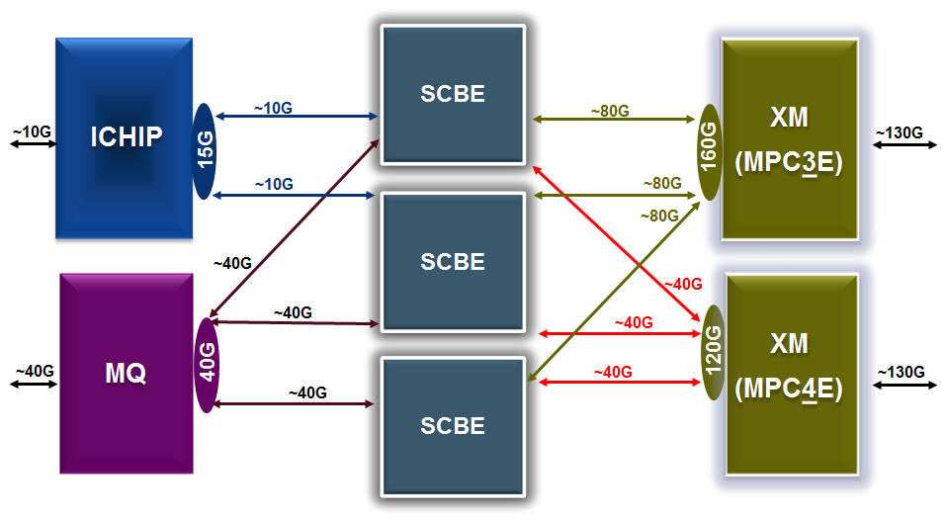
Summary of MX960 Fabric Connectivity
Redundant 3rd SCBE is only activated by user configuration (to support 120Gbps per PFE on MPC4E)
ICHIP can only connect to 2 SCBEs at a time

Slide 29
MX Enhanced Midplane Connector: FAQ (1/3)
Why enhance the midplane connector?
Leverage the latest in connector technology (like we are doing on MX2020)
To be able to run the fabric links faster
Is the entire midplane being changed? What is changing?
No, just the connector that mates the slots to the midplane is changing
The midplane remains identical , no change to design, number of links or traces
What about backward compatibility?
The enhanced connector is 100% compatible with all previous functionality
All previous line cards will work with zero difference
No upgrade of software required – you can use JUNOS 8.X if required
No requalification of any kind is required by customers – the change is transparent
Is the enhanced connector field replaceable
No, it is not field upgradeable

Slide 30
MX Enhanced Midplane Connector: FAQ (2/3)
Are we renaming the platforms?
No, they will still be MX960, MX480, MX240
There will be new ordering bundles – BASE3 and PREMIUM3
BASE3 is identical to BASE; PREMIUM3 is identical to PREMIUM2
How will the user be able to identify a chassis with enhanced midplane
The CLEI of a chassis with enhanced midplane connector will be different
CLI (all prior Junos images included) will show a new backplane version
Via a strip of blue overlay just below the craft panel on the right hand side – Visual Identification
+
Enhanced Midplane
Connector
2+1 SCBE2 mode : 340G
3+0 SCBE2 mode: 480G
+
MX
SCBE2
+
Legacy Midplane
Connector
2+1 SCBE2 mode : 340G
3+0 SCBE2 mode: 480G

Slide 31
MX Enhanced Midplane connector: FAQ (3/3)
Will current BASE/PREMIUM2 bundle SKUs be discontinued?
No immediate plans to discontinue current SKUs
We highly recommend customers to switch over to the new SKUs immediately; since they are fully backward compatible with all hardware and software releases
Is the midplane with enhanced connectors NEBS compliant?
Yes. NEBS reports updated with these new SKUs
What is the target FRS date for chassis with enhanced midplane connector?
MX960 – Shipping
MX480 – Shipping
MX240 – Shipping

Slide 32
FABRIC Bandwidth PER MPC SLOT with PREMIUM3
Fabric Mode | SCB | SCBE | SCBE2 | SCBE3*
3+0 : MX960 2+0: MX240/480 | 120G | 240G | 480G | 1500G
2+1 : MX960 1+1: MX240/480 | 80G | 160G | 340G | 1000G
MPCs Supported | MPC1/2/3/ 16x10G MPC | MPC1/2/3/4/5 16x10G MPC/ MPC2-NG/ MPC3-NG | MPC1/2/3/4/5/7 16x10G MPC/ MPC2-NG/ MPC3-NG | MPC4/5/7/10 16x10G MPC/ MPC2-NG/ MPC3-NG
Minimum Junos for Fabric card** | 10.1R1 | 11.4.R1 | 13.3R1 | On Roadmap
* On Roadmap
** Check Junos support for individual MPCs http://www.juniper.net/documentation/en_US/release-independent/junos/topics/reference/general/mpc-mx-series-supported.html

Slide 33
FABRIC Bandwidth PER MPC SLOT with PREMIUM2
Fabric Mode | SCB | SCBE | SCBE2 | SCBE3*
3+0: MX960 2+0: MX240/480 | 120G | 240G | 480G | 1T
2+1 : MX960 1+1: MX240/480 | 80G | 160G | 340G | 640G
MPCs Supported | MPC1/2/3/ 16x10G MPC | MPC1/2/3/4/5 16x10G MPC/ MPC2-NG/ MPC3-NG | MPC1/2/3/4/5/7 16x10G MPC/ MPC2-NG/ MPC3-NG | MPC4/5/7/10 16x10G MPC/ MPC2-NG/ MPC3-NG
Minimum Junos for Fabric card** | 10.1R1 | 11.4.R1 | 13.3R1 | On Roadmap
* On Roadmap
** Check Junos support for individual MPCs http://www.juniper.net/documentation/en_US/release-independent/junos/topics/reference/general/mpc-mx-series-supported.html

Slide 34
Flow chart
Enhanced Connector Midplane
2+1 SCBE2 mode : 340G
3+0 SCBE2 mode: 480G
MX
SCBE2
2+1 SCBE2 mode : 340G
3+0 SCBE2 mode: 480G
chassis type
Premium 2
(MX+SCBE2)
Fabric Redundancy
Yes
Slide 35
No
Slide 36
Premium 3
(MX+SCBE2+Enhanced Connector)
Fabric Redundancy
Slide 37
Yes
No
Slide 38
View this slide in Presentation Mode

Slide 35
Premium 2 – with Fabric Redundancy
With Fabric Redundancy : 2+1 for MX960; 1+1 for MX240/480
Bandwidth Needed | 80G |  | 130G | 160G | 200G | 340G
Minimum Fabric Card | SCB | SCBE | SCBE | SCBE | SCBE2 | SCBE2
MPC | MPC2 | MPC2-NG | MPC3 MPC3-NG | 16x10G MPC | MPC4/5 | MPC7
Minimum Junos | 10.1R1 | 14.1R4 (JAM) | MPC3- 12.1R1 MPC3-NG- 14.1R4 (JAM) | 11.4R1 | MPC4 -13.3R1 MPC5 – 13.3R4 | 15.1F4 (JAM)
RE/FAN/PS | RE-S-1800x4-16G/32G High Capacity Fan and Power Supply

Slide 36
Premium 2 – without Fabric Redundancy
No Fabric Redundancy : 3+0 for MX960; 2+0 for MX240/480
Bandwidth Needed | 80G |  | 130G |  | 160G | 240G | 240G | 260G | 480G
Minimum Fabric Card | SCB | SCBE | SCB | SCBE | SCBE | SCBE | SCBE2 | SCBE2 | SCBE2
MPC | MPC2 | MPC2-NG | MPC3 | MPC3-NG | 16x10G MPC | MPC4/5 | MPC5 | MPC4 | MPC7
Minimum Junos | 10.1R1 | 14.1R4 (JAM) | 12.1R1 | 14.1R4 (JAM) | 11.4R1 | MPC4 -12.3R2 MPC5 – 13.3R3 | MPC5 – 13.3R3 | MPC4 -13.3R1 | 15.1F4 (JAM)
RE/FAN/PS | RE-S-1800x4-16G/32G High Capacity Fan and Power Supply

Slide 37
Premium 3 – with Fabric Redundancy
With Fabric Redundancy : 2+1 for MX960; 1+1 for MX240/480
Bandwidth Needed | 80G |  | 130G | 160G | 240G | 250G | 340G
Minimum Fabric Card | SCB | SCBE | SCBE | SCBE | SCBE2 | SCBE2 | SCBE2
MPC | MPC2 | MPC2-NG | MPC3 MPC3-NG | 16x10G MPC | MPC5 | MPC4 | MPC7
Minimum Junos | 10.1R1 | 14.1R4 (JAM) | MPC3- 12.1R1 MPC3-NG- 14.1R4 (JAM) | 11.4R1 | 13.3R4 | 13.3R1 | 15.1F4 (JAM)
RE/FAN/PS | RE-S-1800x4-16G/32G High Capacity Fan and Power Supply

Slide 38
Premium 3 – without Fabric Redundancy
Non Fabric Redundancy : 3+0 for MX960; 2+0 for MX240/480
Bandwidth Needed | 80G |  | 130G |  | 160G | 240G | 240G | 260G | 480G
Minimum Fabric Card | SCB | SCBE | SCB | SCBE | SCBE | SCBE | SCBE2 | SCBE2 | SCBE2
MPC | MPC2 | MPC2-NG | MPC3 | MPC3-NG | 16x10G MPC | MPC4/5 | MPC5 | MPC4 | MPC7
Minimum Junos | 10.1R1 | 14.1R4 (JAM) | 12.1R1 | 14.1R4 (JAM) | 11.4R1 | MPC4 -12.3R2 MPC5 – 13.3R3 | MPC5 – 13.3R3 | MPC4 -13.3R1 | 15.1F4 (JAM)
RE/FAN/PS | RE-S-1800x4-16G/32G High Capacity Fan and Power Supply

Slide 39
STEPS to Calculate per slot Bandwidth
STEP1: Determine the type of chassis deployed – PREMIUM2 (Old Connector) or PREMIUM3 (Enhanced Connector)
If PREMIUM3 use the slide Titled “PER SLOT Bandwidth – With PREMIUM3”
If PREMIUM2 use the slide Titled “PER SLOT Bandwidth – With PREMIUM2”
STEP2: Determine if the chassis is going to deployed with fabric redundancy or not
STEP3: Determine the bandwidth required in the relevant table to find out type of MPC, Switch Fabric, Junos, RE, and Fan/PS
Chassis | Fabric Redundancy | Non Fabric Redundancy
MX960 | 2 Active Fabric Card 1 Standby Fabric Card | 3 Active Fabric Card 0 Standby Fabric Card
MX240/480 | 1 Active Fabric Card 1 Standby Fabric Card | 2 Active Fabric Card 0 Standby Fabric Card

Slide 40
Performance with SCBE/SCBE2
For MX240/MX480/MX960
Chassis | SCBE With MPC4E/5E |  | SCBE2 with MPC4E/5E
 | Fabric Redundancy | No Fabric Redundancy | Fabric Redundancy | No Fabric Redundancy
PREMIUM2 | 160G | 240G | 205G | 260G for MPC4E 240G for MPC5E
PREMIUM3 | 160G | 240G | 250G for MPC4E 240G for MPC5E | 260G for MPC4E 240G for MPC5E
Chassis | SCBE2 With MPC7E |  | SCBE2 with MPC1/2/3/16x10G
 | Fabric Redundancy | No Fabric Redundancy | Fabric Redundancy | No Fabric Redundancy
PREMIUM2 | 340G | 480G | Same as SCBE | Same as SCBE
PREMIUM3 | 340G | 480G | Same as SCBE | Same as SCBE

Slide 41
Performance with SCBE3
For MX240/MX480/MX960
Chassis | SCBE3 With NG-MPC2E/3E |  | SCBE3 with MPC4E/5E
 | Fabric Redundancy | No Fabric Redundancy | Fabric Redundancy | No Fabric Redundancy
PREMIUM2 | 80G/130G | 80G/130G | Under Investigation | 260G for MPC4E 240G for MPC5E
PREMIUM3 | 80G/130G | 80G/130G | 260G for MPC4E 240G for MPC5E | 260G for MPC4E 240G for MPC5E
Chassis | SCBE3 With MPC7E* |  | SCBE3 with 1.5T MPC10E for MX960
 | Fabric Redundancy | No Fabric Redundancy | Fabric Redundancy | No Fabric Redundancy
PREMIUM2 | 400G | 480G | 640G | 1T
PREMIUM3 | 480G | 480G | 1T | 1.5T
*MPC7E will see fabric redundancy improvement only with MC960+SCBE3

Slide 42
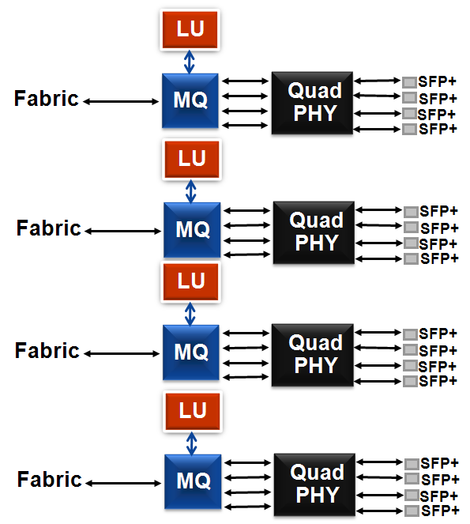
16x10GE MPC Architecture
16x10GE MPC uses 4 Trio PFEs
Fabric Capacity per PFE with SCB
MX960: ~30G full duplex fabric connection with 3 SCBs
MX480/MX240: ~40G full duplex fabric connection with 2 SCBs
Fabric Capacity per PFE with SCBE
MX960: ~40G full duplex fabric connection with 2 SCBEs
MX480/MX240: ~40G full duplex fabric connection with 1 SCBE

Slide 43
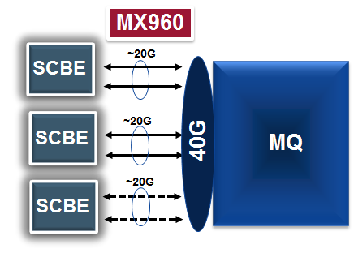
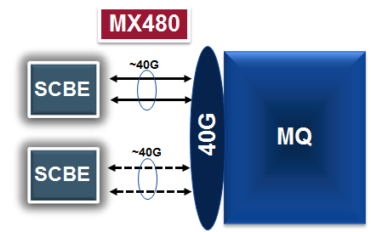
SCBE: Fabric Bandwidth per 16x10GE MPC slot
With all SCBs present, 16-ports are close to line rate per slot
2 active SCBEs on an MX960 chassis
2+1 SCBE redundancy
With all SCBs present, 16-ports are close to line rate per slot
1 active SCBE on an MX480/MX240 chassis
1+1 SCBE redundancy
MQ represents a PFE with 4x10GE ports

Slide 44
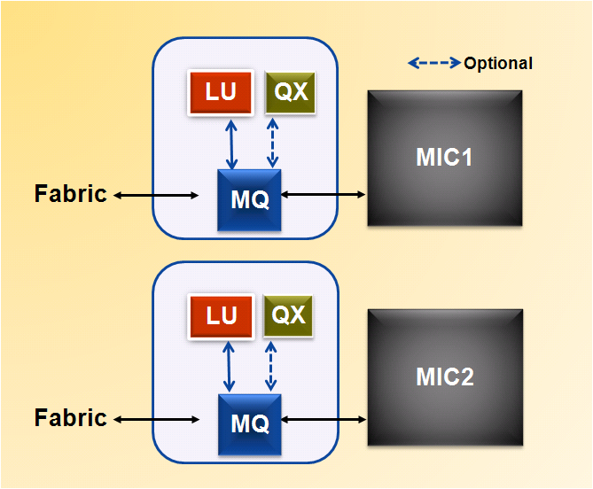
MPC2/MPC1
MPC2 has 2 Trio PFEs
Fabric Capacity per PFE
MX960
~40G full duplex fabric connection with 2 or 3 SCBs
~40G full duplex fabric connection with 2 or 3 SCBEs
MX480/MX240
~40G full duplex fabric connection with 1 or 2 SCBs
~40G full duplex fabric connection with 1 or 2 SCBEs

Slide 45
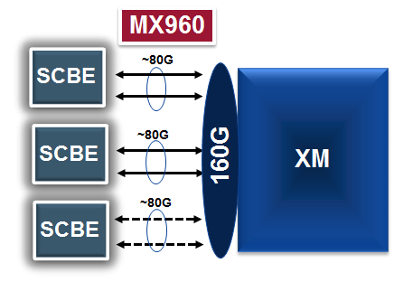

MPC3E
MPC3E has 1 Trio (Cassis) PFE
~130G of PFE capacity
~200G if all traffic stays local to PFE
PFE BW varies by packet size & application
~160G of fabric capacity
Fabric Capacity per PFE: ~160G
With SCBE
MX960: ~80G per SCBE
MX480: ~160G per SCBE
With SCB
MX960: ~40G per SCB
MX480: ~80G per SCB
XM represents a PFE

Slide 46
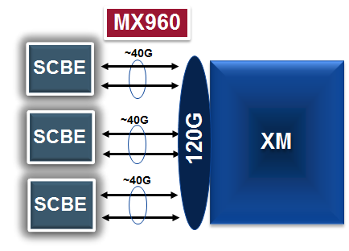
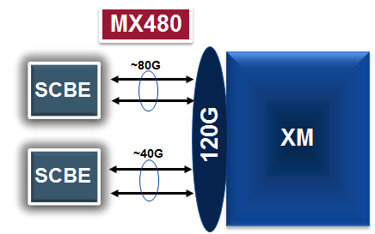
MPC4E: MX960/MX480 PFE/Fabric Bandwidth
MPC4E: Line card 1: 32x10GE
MPC4E: Line card 2: 2x100GE + 8x10GE
MPC4E has 2 Trio (Cassis) PFEs
~130G per PFE bandwidth capacity
~260G of aggregate LC PFE bandwidth
PFE BW varies by packet size & application
Fabric Capacity
With SCBE
MX960: ~40G per SCBE per PFE
MX480: ~80G + ~40G with SCBE per PFE
120G per PFE
240G per LC
SCB is not supported
XM represents a PFE
Note SCBEs operate in redundant mode by default. SCBE’s will have to be configured to operate in non redundant mode to utilize the 240G of non redundant fabric capacity.
See Slide 24 for ICHIP inter-op mode bandwidth

Slide 47
MPC4E fabric connectivity in MX960
MX960 in 3+0 mode (SCBE + CURRENT Mid plane)
MX960 in 3+0 mode (SCBE2 + CURRENT Mid plane)
SCBE
~234G (~240G)/MPC4E
~260G/MPC4E
SCBE2
XM0
~40G
~44G
XM0
~40G
SCBE
~44G
SCBE2
XM1
~40G
~44G
XM1
SCBE
SCBE2
MPC4E
MPC4E
MX960 in 2+1 mode (SCBE2 + CURRENT Mid plane)
MX960 in 2+1 mode (SCBE2 + ENHANCED Mid plane)
~205G/MPC4E
~250G/MPC4E
SCBE2
SCBE2
XM0
~52G
~63G
XM0
~52G
SCBE2
~63G
SCBE2
XM1
XM1
SCBE2
SCBE2
MPC4E
MPC4E

Slide 48
MPC5E Fabric Connectivity in MX960
MX960 in 3+0 mode (SCBE + CURRENT Mid plane)
MX960 in 3+0 mode (SCBE2 + CURRENT Mid plane)
SCBE
~234G (~240G)/MPC5E
~240G/MPC5E
SCBE2
XM0
~40G
~40G
XM0
~40G
SCBE
~40G
SCBE2
XM1
~40G
~40G
XM1
SCBE
SCBE2
MPC5E
MPC5E
MX960 in 2+1 mode (SCBE2 + CURRENT Mid plane)
MX960 in 2+1 mode (SCBE2 + ENHANCED Mid plane)
~205G/MPC5E
~240G/MPC5E
SCBE2
SCBE2
XM0
~52G
~60G
XM0
~52G
SCBE2
~60G
SCBE2
XM1
XM1
SCBE2
SCBE2
MPC5E
MPC5E

Slide 49
MPC7E Fabric Connectivity in MX960
MX960 in 3+0 mode (SCBE2 + CURRENT Mid plane)
MX960 in 3+0 mode (SCBE2 + ENHANCED Mid plane)
SCBE2
~480G/MPC7E
~480G/MPC7E
SCBE2
EA0
~80
~80G
EA0
~80G
SCBE2
~80G
SCBE2
EA1
~80G
~80G
EA1
SCBE2
SCBE2
MPC7E
MPC7E
MX960 in 2+1 mode (SCBE2 + CURRENT Mid plane)
MX960 in 2+1 mode (SCBE2 + ENHANCED Mid plane)
~340G/MPC7E
~340/MPC7E
SCBE2
SCBE2
EA0
~85G
~85G
EA0
~85G
SCBE2
~85G
SCBE2
EA1
EA1
SCBE2
SCBE2
MPC7E
MPC7E

Slide 50
MPC7E Fabric Connectivity in MX240/480
MX240/480 in 2+0 mode (SCBE2 + CURRENT Mid plane)
MX240/480 in 2+0 mode (SCBE2 + ENHANCED Mid plane)
SCBE2
~480G/MPC7E
~480G/MPC7E
SCBE2
EA0
~120G
~120G
EA0
~120G
SCBE2
~120G
SCBE2
EA1
EA1
MPC7E
MPC7E
MX240/480 in 1+1 mode (SCBE2 + CURRENT Mid plane)
MX240/480 in 1+1 mode (SCBE2 + ENHANCED Mid plane)
~340G/MPC7E
~340/MPC7E
SCBE2
SCBE2
EA0
~170G
~170G
EA0
SCBE2
SCBE2
EA1
EA1
MPC7E
MPC7E

Slide 51
MPC7E/8E/9E Fabric Connectivity
CHASSIS | FABRIC | LINE CARD | FABRIC STATE | BANDWIDTH, GBPS
MX960/480/240, all chassis, PREMIUM2 / PREMIUM3 | SCBE2 | MPC7E | ALL ACTIVE | 480
 |  |  | ONE FAILS | 342
MX2K | SFB | MPC7E | ALL ACTIVE | 401
 |  |  | ONE FAILS | 368
 | SFB2 | MPC7E MPC7E | ALL ACTIVE | 427
 |  |  | ONE FAILS | 374
 | SFB | MPC8E | ALL ACTIVE | 800
 |  |  | ONE FAILS | 737
 | SFB2 | MPC8E | ALL ACTIVE | 960
 |  |  | ONE FAILS
 |  |  | TWO FAIL | 935
 | SFB | MPC9E | ALL ACTIVE | 802
 |  |  | ONE FAILS | 737
 | SFB2 | MPC9E | ALL ACTIVE | 1600
 |  |  | ONE FAILS
 |  |  | TWO FAIL | 1572
Notes:
51

Slide 52
MPC7E-MRATE: full duplex Bandwidth per PFE with SCBE2 (3+0 Mode in PREMIUM2/3 chassis) with Hypermode
L2 Packet Size (Byte) | Total BW per PFE (G) | Total BW per PFE with IPG (G) | MPPS | Line Rate % | Uncongested 10G Latency (Microseconds)
64 | 118 | 155 | 236.00 | 66.25% | 17.25
128 | 208 | 240 | 202.70 | 100% | 17.95
256 | 223 | 240 | 108.69 | 100% | 18.46
512 | 235 | 240 | 56.39 | 100% | 18.45
1020 | 231 | 240 | 28.84 | 100% | 18.48
5192 | 239 | 240 | 5.75 | 100% | 19.04
9000 | 239 | 240 | 3.32 | 100% | 19.50
Two PFEs per line card. Per PFE capacity is 240G. Per slot capacity 480G
Test done with 15.1F5
Forwarding to 500K prefixes, all traffic is crossing fabric.

Slide 53
MPC7E-10G: full duplex Bandwidth per PFE with SCBE2 (3+0 Mode in PREMIUM2/3 chassis) with Hypermode
L2 Packet Size (Byte) | Total BW per PFE (G) | Total BW per PFE with IPG (G) | MPPS | Line Rate % | Uncongested 10G Latency (Microseconds)
64 | 119 | 155 | 232.75 | 78% | 18.07
128 | 173 | 200 | 168.92 | 100% | 18.08
256 | 186 | 200 | 90.58 | 100% | 18.63
512 | 192 | 200 | 46.99 | 100% | 18.77
1020 | 196 | 200 | 24.04 | 100% | 18.37
5192 | 199 | 200 | 4.80 | 100% | 20.13
9000 | 200 | 200 | 2.71 | 100% | 21.15
Two PFEs per line card. Per PFE capacity is 200G. Per slot capacity 400G
Test done with 15.1F5
Forwarding to 500K prefixes, all traffic is crossing fabric.

Slide 54
MX2K-MPC8E: full duplex Bandwidth per PFE SFB2 (8 fabrics active) with Hypermode
L2 Packet Size (Byte) | Total BW per PFE (G) | Total BW per PFE with IPG (G) | MPPS | Line Rate % | Uncongested 10G Latency (Microseconds)
64 | 118 | 155 | 236.00 | 66% | 17.25
128 | 208 | 240 | 202.70 | 100% | 17.94
256 | 223 | 240 | 108.69 | 100% | 18.44
512 | 235 | 240 | 56.39 | 100% | 18.45
1020 | 231 | 240 | 28.84 | 100% | 18.48
5192 | 239 | 240 | 5.75 | 100% | 19.04
9000 | 239 | 240 | 3.32 | 100% | 19.50
Four PFEs per line card. Per PFE capacity is 240G. Per slot capacity 960G
Test done with 15.1F5
Forwarding to 500K prefixes, all traffic is crossing fabric.

Slide 55
MX2K-MPC9E: full duplex Bandwidth per PFE SFB2 (8 fabrics active) with Hypermode
L2 Packet Size (Byte) | Total BW per PFE (G) | Total BW per PFE with IPG (G) | MPPS | Line Rate % | Uncongested 10G Latency (Microseconds)
64 | 198 | 259 | 385.97 | 65% | 13.48
128 | 346 | 400 | 337.83 | 100% | 14.00
256 | 371 | 400 | 181.16 | 100% | 14.52
512 | 385 | 400 | 93.98 | 100% | 14.84
1020 | 392 | 400 | 48.08 | 100% | 14.52
5192 | 398 | 400 | 9.59 | 100% | 15.63
9000 | 399 | 400 | 5.54 | 100% | 16.19
Four PFEs per line card. Per PFE capacity is 400G. Per slot capacity 1600G
Test done with 15.1F5
Forwarding to 500K prefixes, all traffic is crossing fabric.

Slide 56
MX2K-MPC6E: full duplex Bandwidth per PFE with SFB + 2x100G MIC with Hypermode
L2 Packet Size (Byte) | Total BW per PFE (G) | Total BW per PFE with IPG (G) | MPPS | Line Rate % | Uncongested 10G Latency (Microseconds)
64 | 81 | 100 | 131 | 100% | 11.6
128 | 100 | 100 | 83.3 | 100% | 12.0
256 | 100 | 100 | 44.6 | 100% | 12.0
512 | 100 | 100 | 23.6 | 100% | 12.1
1020 | 100 | 100 | 12.0 | 100% | 12.2
5192 | 100 | 100 | 2.4 | 100% | 13.2
9000 | 100 | 100 | 1.4 | 100% | 13.9
Four PFEs per line card. Per PFE capacity is 100G (I/O limited). Per slot capacity 400G (I/O limited)
Test done with 13.3R3 with Hypermode

Slide 57
MX2K-MPC6E: full duplex Bandwidth per PFE with SFB + 24x10G MIC with Hypermode
L2 Packet Size (Byte) | Total BW per PFE (G) | Total BW per PFE with IPG (G) | MPPS | Line Rate % | Uncongested 10G Latency (Microseconds)
64 | 81 | 106 | 157.2 | 88% | 11.8
128 | 102 | 118 | 99.2 | 98% | 12.2
256 | 111 | 120 | 54.4 | 100% | 12.2
512 | 116 | 120 | 28.2 | 100% | 12.6
1020 | 118 | 120 | 14.4 | 100% | 12.6
5192 | 120 | 120 | 2.9 | 100% | 14.0
9000 | 120 | 120 | 1.7 | 100% | 15.5
Four PFEs per line card. Per PFE capacity is 120G. Per slot capacity 480G
Test done with 13.3R3 with Hypermode

Slide 58
MX2K-MPC6E: full duplex Bandwidth per PFE with SFB + 4x100G CXP MIC with Hypermode
L2 Packet Size (Byte) | Total BW per PFE (G) | Total BW per PFE with IPG (G) | MPPS | Line Rate % | Uncongested 10G Latency (Microseconds)
64 | 73 | 96 | 142.3 | 48% | 11.6
128 | 102 | 118 | 99.64 | 59% | 11.9
256 | 121 | 130 | 58.88 | 65% | 12.2
512 | 125 | 130 | 30.55 | 65% | 12.3
1020 | 128 | 130 | 15.63 | 65% | 12.8
5192 | 130 | 130 | 3.12 | 65% | 13.4
9000 | 130 | 130 | 1.80 | 65% | 13.4
Four PFEs per line card. Per PFE capacity is 130G. Per slot capacity 520G
Test done with 13.3R4 with Hypermode

Slide 59
MX2K-MPC6E: full duplex Bandwidth per PFE with SFB + 24x10G MIC no Hypermode
L2 Packet Size (Byte) | Total BW per PFE (G) | Total BW per PFE with IPG (G) | MPPS | Line Rate % | Uncongested 10G Latency (Microseconds)
64 | 67 | 88 | 130.9 | 73% | 12.6
128 | 102 | 117 | 99.2 | 98% | 13.0
256 | 111 | 120 | 54.4 | 100% | 13.2
512 | 116 | 120 | 28.2 | 100% | 13.0
1020 | 118 | 120 | 14.4 | 100% | 13.9
5192 | 120 | 120 | 2.9 | 100% | 15.3
9000 | 120 | 120 | 1.7 | 100% | 16.9
Four PFEs per line card. Per PFE capacity is 120G. Per slot capacity 480G
Test done with 13.3R3

Slide 60
MX2K-MPC6E: full duplex Bandwidth per PFE with SFB + 4x100G CXP MIC no Hypermode
L2 Packet Size (Byte) | Total BW per PFE (G) | Total BW per PFE with IPG (G) | MPPS | Line Rate % | Uncongested 10G Latency (Microseconds)
64 | 66 | 87 | 129.5 | 44% | 13.0
128 | 102 | 118 | 99.6 | 59% | 13.3
256 | 121 | 130 | 58.9 | 65% | 13.2
512 | 125 | 130 | 30.6 | 65% | 12.9
1020 | 128 | 130 | 15.6 | 65% | 13.1
5192 | 130 | 130 | 3.1 | 65% | 13.9
9000 | 130 | 130 | 1.8 | 65% | 14.4
Four PFEs per line card. Per PFE capacity is 130G. Per slot capacity 520G
Test done with 13.3R3

Slide 61
MPC5E-40G10G: full duplex Bandwidth per PFE with SCBE2 (2+1 Mode in PREMIUM2 chassis) with Hypermode
L2 Packet Size (Byte) | Total BW per PFE (G) | Total BW per PFE with IPG (G) | MPPS | Line Rate % | Uncongested 10G Latency (Microseconds)
64 | 79 | 104 | 154.7 | 87% | 12.9
128 | 101 | 117 | 98.5 | 98% | 13.2
256 | 103 | 111 | 50.1 | 92% | 13.0
512 | 103 | 107 | 25.0 | 89% | 13.2
1020 | 102 | 104 | 12.5 | 87% | 13.5
5192 | 102 | 102 | 2.4 | 85% | 14.0
9000 | 102 | 102 | 1.4 | 85% | 15.0
Two PFEs per line card. Per PFE capacity is 120G. Per slot capacity 240G in this mode
Test done with 13.3R3

Slide 62
MPC5E-40G10G: full duplex Bandwidth per PFE with SCBE2 (2+1 Mode in PREMIUM3 chassis) with Hypermode
L2 Packet Size (Byte) | Total BW per PFE (G) | Total BW per PFE with IPG (G) | MPPS | Line Rate % | Uncongested 10G Latency (Microseconds)
64 | 80 | 105 | 129.9 | 87% | 12.9
128 | 102 | 117 | 82.6 | 98% | 13.2
256 | 111 | 120 | 45.2 | 100% | 13.0
512 | 115 | 120 | 23.4 | 100% | 13.2
1020 | 118 | 120 | 12 | 100% | 13.5
5192 | 120 | 120 | 2.3 | 100% | 14.0
9000 | 120 | 120 | 1.3 | 100% | 15.0
Two PFEs per line card. Per PFE capacity is 120G. Per slot capacity 240G in this mode
Test done with 13.3R3

Slide 63
MPC5E-40G10G: full duplex Bandwidth per PFE with SCBE2 (2+1 Mode in PREMIUM2 chassis)
L2 Packet Size (Byte) | Total BW per PFE (G) | With IPG (G) | MPPS | Line Rate % | Uncongested 10G Latency (Microseconds)
64 | 66 | 86 | 128.4 | 72% | 13.7
128 | 102 | 118 | 99.2 | 98% | 14.2
256 | 103 | 111 | 50.0 | 92% | 14.4
512 | 103 | 107 | 25.0 | 89% | 14.4
1020 | 102 | 104 | 12.5 | 87% | 14.4
5192 | 102 | 102 | 2.5 | 85% | 14.6
9000 | 102 | 102 | 1.4 | 85% | 16.0
Two PFEs per line card; Per slot capacity 240G in this mode

Slide 64
MPC5E-40G10G: full duplex Bandwidth per PFE with SCBE2 (2+1 Mode in PREMIUM3 chassis)
L2 Packet Size (Byte) | Total BW per PFE (G) | With IPG (G) | MPPS | Line Rate % | Uncongested 10G Latency (Microseconds)
64 | 65 | 87 | 105.9 | 73% | 12.8
128 | 102 | 118 | 82.6 | 98% | 13.6
256 | 111 | 120 | 45.2 | 100% | 13.9
512 | 115 | 120 | 23.4 | 100% | 13.9
1020 | 118 | 120 | 12.0 | 100% | 14.4
5192 | 120 | 120 | 2.3 | 100% | 16.4
9000 | 120 | 120 | 1.3 | 100% | 17.4
Two PFEs per line card; Per slot capacity 240G in this mode

Slide 65
MPC5EQ-40G10G: full duplex Bandwidth per PFE with SCBE2 (2+1 Mode in PREMIUM2 chassis) with Hypermode
L2 Packet Size (Byte) | Total BW per PFE (G) | Total BW per PFE with IPG (G) | MPPS | Line Rate % | Uncongested 10G Latency (Microseconds)
64 | 51 | 67 | 99.5 | 56% | 13.2
128 | 102 | 118 | 99.2 | 98% | 14.3
256 | 103 | 111 | 50.1 | 92% | 14.5
512 | 103 | 107 | 25 | 89% | 14.5
1024 | 102 | 104 | 12.5 | 87% | 14.3
5192 | 102 | 102 | 2.5 | 85% | 15
9000 | 102 | 102 | 1.4 | 85% | 16.1
Two PFEs per line card. Per PFE capacity is 120G. Per slot capacity 240G in this mode
Test done with 13.3R3

Slide 66
MPC5EQ-40G10G: full duplex Bandwidth per PFE with SCBE2 (2+1 Mode in PREMIUM3 chassis) with Hypermode
L2 Packet Size (Byte) | Total BW per PFE (G) | Total BW per PFE with IPG (G) | MPPS | Line Rate % | Uncongested 10G Latency (Microseconds)
64 | 51 | 67 | 83.3 | 56% | 13.2
128 | 102 | 118 | 82.7 | 98% | 14.3
256 | 111 | 120 | 45.2 | 100% | 14.5
512 | 116 | 120 | 23.4 | 100% | 14.5
1024 | 118 | 120 | 12.0 | 100% | 14.3
5192 | 120 | 120 | 23.9 | 100% | 15.0
9000 | 120 | 120 | 13.8 | 100% | 16.1
Two PFEs per line card. Per PFE capacity is 120G. Per slot capacity 240G in this mode
Test done with 13.3R3

Slide 67
MPC2E-3D-NG: Full duplex Bandwidth per PFE with SCBE
L2 Packet Size (Byte) | Total BW per PFE (G) IPG + Preamble | MPPS | Line Rate % | Uncongested 10G Latency (Microseconds)
64 | 61 | 90.6 | 76% | 15.8
128 | 64 | 54.3 | 80% | 16.4
256 | 80 | 36.2 | 100% | 16.9
512 | 80 | 18.8 | 100% | 17.1
1024 | 80 | 9.6 | 100% | 17.8
1518 | 80 | 6.5 | 100% | 17.9
2048 | 80 | 4.8 | 100% | 18.3
9000 | 80 | 1.1 | 100% | 20.0
MIC-3D-4XGE-XFP and 8X10G Ports used in testing
One PFEs per line card. Per PFE capacity is 80G. Per slot capacity 80G

Slide 68
MPC3E-3D-NG: Full duplex Bandwidth per PFE with SCBE2
L2 Packet Size (Byte) | Total BW per PFE (G) IPG + Preamble | MPPS | Line Rate % | Uncongested 10G Latency (Microseconds)
64 | 122 | 181.2 | 94% | 18.18
128 | 118 | 99.8 | 91% | 18.73
256 | 130 | 58.9 | 100% | 18.78
512 | 130 | 30.5 | 100% | 18.65
1024 | 130 | 15.6 | 100% | 19.46
1518 | 130 | 10.6 | 100% | 19.74
2048 | 130 | 7.9 | 100% | 19.27
9000 | 130 | 1.8 | 100% | 23.93
MIC3-3D-10XGE-SFPP MIC and 13X10G Ports used in testing
One PFEs per line card. Per PFE capacity is 130G. Per slot capacity 130G

Slide 69
MPC2E-3D-NG-Q: INGRESS QUEUING Full duplex Bandwidth per PFE with SCBE
L2 Packet Size (Byte) | Total BW per PFE (G) IPG + Preamble | MPPS | Line Rate % | Uncongested 10G Latency (Microseconds)
64 | 40 | 59.8 | 67% | 24.1
128 | 43 | 36.1 | 71% | 24.9
256 | 60 | 27.2 | 100% | 25.6
512 | 60 | 14.1 | 100% | 25.4
1024 | 60 | 7.2 | 100% | 26.3
1518 | 60 | 4.9 | 100% | 27.0
2048 | 60 | 3.6 | 100% | 27.6
9000 | 60 | 0.8 | 100% | 32.1
MIC-3D-4XGE-XFP and 6X10G Ports used in testing
One PFEs per line card. Per PFE capacity is 80G. Per slot capacity 80G

Slide 70
MPC3E-3D-NG-Q: INGRESS QUEUING Full duplex Bandwidth per PFE with SCBE2
L2 Packet Size (Byte) | Total BW per PFE (G) IPG + Preamble | MPPS | Line Rate % | Uncongested 10G Latency (Microseconds)
64 | 61 | 91.4 | 77% | 24.93
128 | 80 | 67.6 | 100% | 26.34
256 | 80 | 36.2 | 100% | 26.13
512 | 80 | 18.8 | 100% | 26.35
1024 | 80 | 9.6 | 100% | 26.43
1518 | 80 | 6.5 | 100% | 27.54
2048 | 80 | 4.8 | 100% | 26.99
9000 | 80 | 1.1 | 100% | 32.88
MIC3-3D-10XGE-SFPP MIC and 8X10G Ports used in testing
One PFEs per line card. Per PFE capacity is 130G. Per slot capacity 130G

Slide 71
MPC4E-32x10G: full duplex Bandwidth per PFE with SCBE2 (3+0 Mode in PREMIUM2 chassis) with Hypermode
Testing done with 120G bidirectional per PFE
L2 Packet Size (Byte) | Total BW per PFE with IPG (G) | MPPS per PFE | Line Rate %
64 | 88 | 130.5 | 73%
128 | 112 | 94.4 | 93%
136 | 120 | 96.3 | 100%
256 | 120 | 53.6 | 100%
512 | 120 | 28.3 | 100%
1024 | 120 | 14 | 100%
1518 | 120 | 9.7 | 100%
5912 | 120 | 2.53 | 100%
9000 | 120 | 1.7 | 100%
For small packets (64 bytes) Hypermode offers ~32% better performance for PPS capacity and throughput (Gbps)
Two PFEs per line card. Per PFE capacity is 120G
Full RFC2544 test results available here: https://junipernetworks.sharepoint.com/teams/RBU/plm/Edge/collateral/Documents/Feature/Hypermode/MPC4_RFC2544_MX960_SCBE2_Hypermode.xlsx

Slide 72
MPC4E-32x10G: full duplex Bandwidth per PFE with SCBE2 (2+1 Mode in PREMIUM3 chassis)
L2 Packet Size (Byte) | Total BW per PFE (G) | With IPG (G) | MPPS | Line Rate % | Uncongested 10G Latency (Microseconds)
64 | 49 | 65 | 96.1 | 52% | 17.8
128 | 83 | 96 | 81.1 | 77% | 15.4
256 | 120 | 130 | 60.2 | 104% | 15.2
512 | 123 | 128 | 30.2 | 102% | 15.3
1024 | 123 | 126 | 15.1 | 100% | 15.5
1518 | 122 | 124 | 10.1 | 99% | 15.8
2048 | 125 | 125 | 7.5 | 100% | 15.7
9000 | 124 | 124 | 1.7 | 99.0% | 17.5
Two PFEs per line card; Per slot capacity 250G in this mode

Slide 73
MPC4E-32x10G: full duplex Bandwidth per PFE with SCBE2 (3+0 Mode in PREMIUM3 chassis)
L2 Packet Size (Byte) | Total BW per PFE (G) | With IPG (G) | MPPS | Line Rate % | Uncongested 10G Latency (Microseconds)
64 | 61 | 81 | 119.8 | 62% | 17.8
128 | 92 | 106 | 89.9 | 82% | 15.4
256 | 120 | 130 | 60.2 | 100% | 15.2
512 | 125 | 130 | 30.7 | 100% | 15.3
1024 | 128 | 130 | 15.6 | 100% | 15.5
1518 | 128 | 130 | 10.6 | 100% | 15.8
2048 | 129 | 130 | 7.9 | 100% | 15.8
9000 | 130 | 130 | 1.8 | 100% | 17.5
Two PFEs per line card; Per slot capacity 260G in this mode

Slide 74
MPC4E-32x10G: full duplex Bandwidth per PFE with SCBE2 (3+0 Mode in PREMIUM2 chassis)
L2 Packet Size (Byte) | Total BW per PFE (G) | With IPG (G) | MPPS | Line Rate % | Uncongested 10G Latency (Microseconds)
64 | 56 | 70 | 87.2 | 54% | 17.8
128 | 88 | 102 | 85.8 | 78% | 15.4
256 | 120 | 130 | 60.2 | 100% | 15.2
512 | 125 | 130 | 30.7 | 100% | 15.3
1024 | 128 | 130 | 15.6 | 100% | 15.5
1518 | 128 | 130 | 10.6 | 100% | 15.9
2048 | 129 | 130 | 7.9 | 100% | 15.8
9000 | 130 | 130 | 1.8 | 100% | 17.5
Two PFEs per line card; Per slot capacity 260G in this mode

Slide 75
MPC4E-32x10G: full duplex Bandwidth per PFE with SCBE
L2 Packet Size (Byte) | Total BW per PFE (G) | With IPG (G) | MPPS | Line Rate % | Uncongested 10G Latency (Microseconds)
64 | 51 | 67 | 98.7 | 56% | 13.5
128 | 95 | 109 | 92.3 | 91% | 14.5
256 | 111 | 120 | 55.5 | 100% | 14.4
512 | 114 | 118 | 27.8 | 98% | 14.9
1024 | 114 | 116 | 13.9 | 97% | 15.5
1518 | 113 | 114 | 9.3 | 95% | 16.2
2048 | 114 | 115 | 6.9 | 96% | 16.5
9000 | 114 | 114 | 1.6 | 95% | 24
Two PFEs per line card; Per slot capacity 240G in this mode

Slide 76
MPC4E-2x100G+8x10G: full duplex Bandwidth per PFE with MX2000
L2 Packet Size (Byte) | Total BW per PFE (G) | With IPG (G) | MPPS | Line Rate % | Uncongested 100G Latency (Microseconds)
64 | 51 | 67 | 99.9 | 56% | 14.5
128 | 94 | 109 | 91.6 | 90% | 14.5
256 | 118 | 127 | 64.8 | 100% | 14.6
512 | 132 | 137 | 32.3 | 100% | 14.9
1024 | 132 | 134 | 16.1 | 100% | 15.4
1518 | 131 | 132 | 10.7 | 100% | 15.6
2048 | 132 | 133 | 8 | 100% | 15.9
9000 | 132 | 132 | 1.8 | 100% | 17.7
Two PFEs per line card; Per slot capacity 260G in this mode

Slide 77
MPC3E: full duplex Bandwidth per PFE with SCBE
L2 Packet Size | Total BW per PFE (G) | With IPG (G) | MPPS
64 | 76 | 100 | 149Mpps
128 | 93 | 108 | 90.99Mpps
256 | 105 | 113 | 51.30Mpps
512 | 133 | 138 | 32.41Mpps
1024 | 133 | 135 | 16.20Mpps
1518 | 131 | 133 | 10.78Mpps
2048 | 133 | 134 | 8.09Mpps
9000 | 131 | 132 | 1.79Mpps
One PFE per line card; Per slot capacity 130G in this mode
RFC2544 IPv4 Test results, results may vary

Slide 78
16x10GE MPC: Full Duplex Bandwidth per PFE with SCBE
L2 Packet Size | Total BW per PFE (G) | With IPG (G) | MPPS | Line Rate % | Uncongested Latency (Microseconds)
64 | 25 | 33 | 48.36 | 81% | 13.96
128 | 35 | 40 | 33.78 | 100% | 14.46
256 | 37 | 39 | 17.85 | 99% | 15.42
512 | 38 | 39 | 9.22 | 98% | 15.78
1024 | 38 | 38 | 4.61 | 96% | 16.04
1518 | 38 | 38 | 3.07 | 95% | 16.30
2048 | 38 | 38 | 2.31 | 95% | 16.60
9000 | 38 | 38 | 0.52 | 94% | 19.92
Four PFEs per line card; Per slot capacity 160G in this mode
RFC2544 IPv4 Test results, results may vary

Slide 79
MPC1: Full Duplex Bandwidth per PFE
L2 Packet Size | Total BW per PFE (G) | With IPG (G) | MPPS | Line Rate % | Uncongested 10GE Latency (Microseconds)
64 | 27 | 36 | 52.82 | 89% | 13.96
128 | 35 | 40 | 33.78 | 100% | 14.46
256 | 36 | 39 | 17.85 | 98% | 15.42
512 | 38 | 39 | 9.22 | 98% | 15.78
1024 | 38 | 38 | 4.61 | 96% | 16.04
1518 | 37 | 38 | 3.07 | 94% | 16.30
2048 | 38 | 38 | 2.31 | 95% | 16.60
9000 | 38 | 38 | 0.52 | 94% | 19.92
One PFE per line card; Per slot capacity 40G in this mode
Results apply to both SCB and SCBE
RFC2544 IPv4 Test results, results may vary

Slide 80
MPC1-Q: Full Duplex Bandwidth per PFE
Each QX per PFE is further divided into two halves
Each MIC gets half of QX
Each QX half gets half the bandwidth below
L2 Packet Size | Total BW per PFE (with QX) (G) | With IPG (G) | MPPS | Line Rate %
64 | 21 | 27 | 40.20 | 68%
128 | 35 | 40 | 33.78 | 100%
256 | 37 | 39 | 17.85 | 98%
512* | 33 | 34 | 8.04 | 86%
1024 | 37 | 38 | 4.61 | 95%
1518 | 37 | 38 | 3.07 | 95%
2048 | 38 | 40 | 2.31 | 95%
9000 | 38 | 40 | 0.52 | 94%
One PFE per line card; Per slot capacity 40G in this mode
Results apply to both SCB and SCBE
RFC2544 IPv4 Test results, results may vary

Slide 81
MPC2: Full Duplex Bandwidth per PFE
L2 Packet Size | Total BW per PFE (G) | With IPG (G) | MPPS | Line Rate % | Uncongested 10GE Latency (Microseconds)
64 | 27 | 36 | 52.82 | 89% | 13.96
128 | 35 | 40 | 33.78 | 100% | 14.46
256 | 36 | 39 | 17.85 | 98% | 15.42
512* | 38 | 39 | 9.22 | 98% | 15.78
1024 | 38 | 38 | 4.61 | 96% | 16.04
1518 | 37 | 38 | 3.07 | 94% | 16.30
2048 | 38 | 38 | 2.31 | 95% | 16.60
9000 | 38 | 38 | 0.52 | 94% | 19.92
Two PFEs per line card; Per slot capacity 80G in this mode
Results apply to both SCB and SCBE
RFC2544 IPv4 Test results, results may vary

Slide 82
Q/EQ MPCs: Full Duplex Bandwidth per PFE
MPC2 has 2 Trio PFEs
Each QX per PFE is further divided into two halves
Either 1 port (with 2x10GE MIC), or 2 ports (with 4x10GE MIC) per half
Each QX half gets half the bandwidth below
L2 Packet Size | Total BW per PFE (with QX) (G) | With IPG (G) | MPPS | Line Rate %
64 | 21 | 27 | 40.20 | 68%
128 | 35 | 40 | 33.78 | 100%
256 | 37 | 39 | 17.85 | 98%
512 | 33 | 34 | 8.04 | 86%
1024 | 37 | 38 | 4.61 | 95%
1518 | 37 | 38 | 3.07 | 95%
2048 | 38 | 38 | 2.31 | 95%
9000 | 38 | 38 | 0.52 | 94%
Two PFEs per line card; Per slot capacity 80G in this mode
RFC2544 IPv4 Test results, results may vary
Results apply to both SCB and SCBE

Slide 83
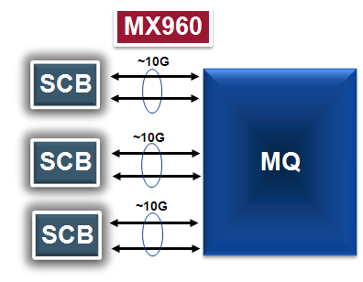
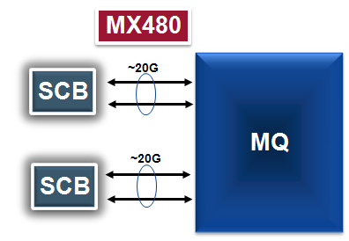
SCB: Fabric Bandwidth per 16x10GE MPC slot
Number of line rate ports per MPC slot depends on the SCB configuration
With all SCBs present, 12-ports are line rate per slot
3 active SCBs on an MX960 chassis
With all SCBs present, 16-ports are close to line rate per slot
2 active SCBs on an MX480/MX240 chassis
Graceful degradation if an SCB fails
To maintain SCB redundancy
Allows the ability to disable 8 ports per slot
8 ports are line rate per slot
MQ represents a PFE with 4x10GE ports

Slide 84
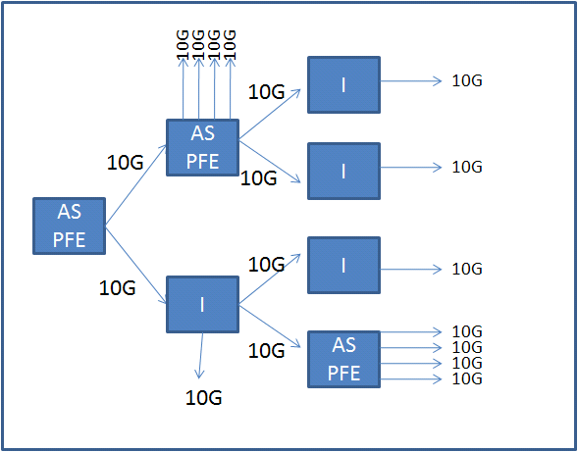
Multicast

Slide 85
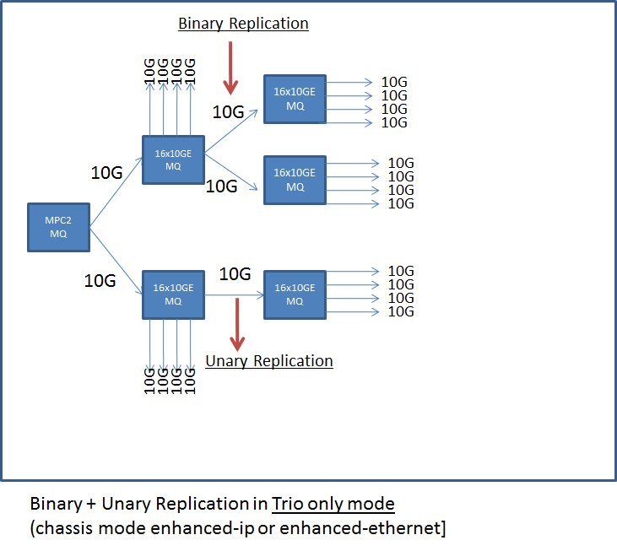
Trio only Multicast

Slide 86
More Resources
MX collateral
https://junipernetworks.sharepoint.com/teams/RBU/plm/Edge/collateral/SitePages/Home.aspx
MX Buying Guide
https://junipernetworks.sharepoint.com/teams/RBU/plm/Edge/collateral/Documents/Sales/MX%20Buying%20Guide.pptx

